Slide 1

Sales Dashboard Comparison
Operational vs Tactical vs Strategic Dashboards

Slide 2
Operational Sales Dashboard
📊 Dashboard Type: Operational
📌 Metrics:
- Daily Sales Volume
- Conversion Rate
- Customer Complaints
- Inventory Levels
👥 Stakeholders Impacted:
- Sales Reps
- Customer Service
- Warehouse Staff
🎯 Impact on Decision-Making:
Supports real-time decisions and immediate corrective actions.
💡 Insights to Improve Company:
Identify bottlenecks in daily operations and improve customer response time.

Slide 3
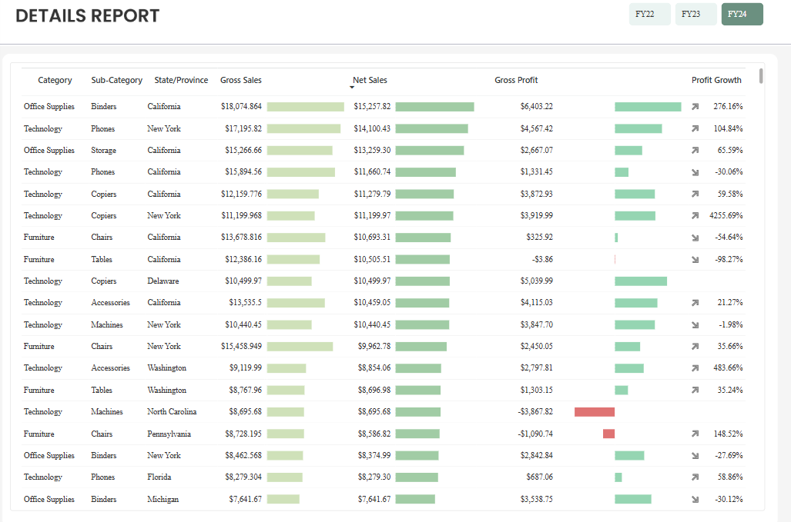
Operational

Slide 4
Tactical Sales Dashboard
📊 Dashboard Type: Tactical
📌 Metrics:
- Monthly Revenue
- Lead Conversion Rate
- Sales by Region
- Customer Retention
👥 Stakeholders Impacted:
- Sales Managers
- Marketing Team
- Regional Supervisors
🎯 Impact on Decision-Making:
Helps in planning campaigns, allocating resources, and managing team performance.
💡 Insights to Improve Company:
Optimize regional strategies and improve lead nurturing processes.

Slide 5
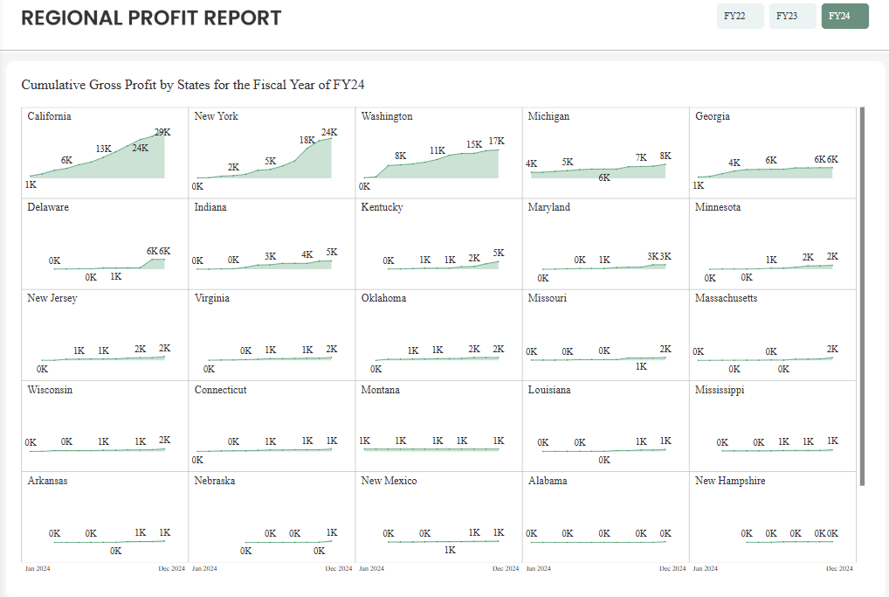
Tactical

Slide 6
Strategic Sales Dashboard
📊 Dashboard Type: Strategic
📌 Metrics:
- Annual Growth Rate
- Market Share
- Customer Lifetime Value
- Profit Margins
👥 Stakeholders Impacted:
- Executives
- Board Members
- Investors
🎯 Impact on Decision-Making:
Guides long-term planning and investment decisions.
💡 Insights to Improve Company:
Align sales goals with company vision and explore new market opportunities.

Slide 7
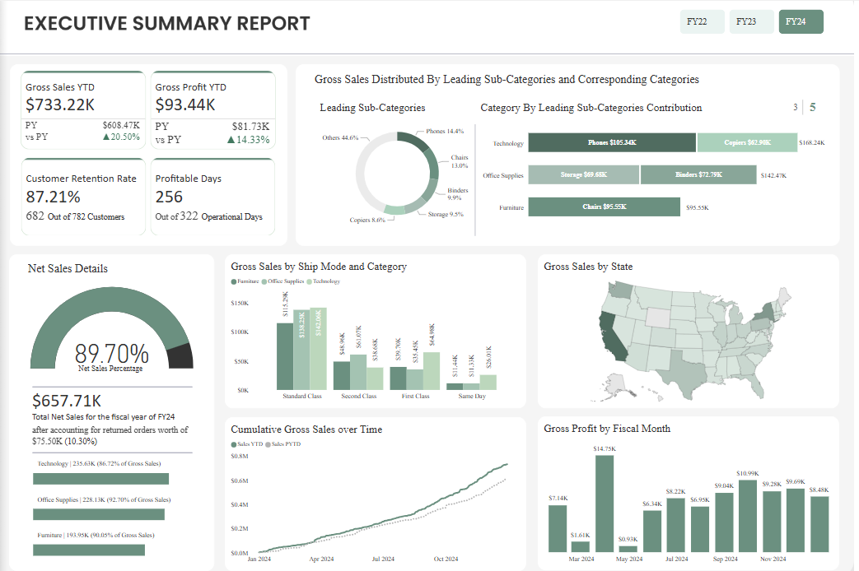
Strategic

